Slide 1
Groups 1 & 2, the Alkali Metals and the Alkaline Earth metals

Slide 2
Group 1 & 2 – The alkali metals and the alkaline earth metals
Li
Na
K
Rb
Cs
Fr

Slide 3
Representative Elements
Groups 1 and 2
Groups 1 and 2 are always found in nature combined with other elements.
They’re called active metals because of their readiness to form new substances with other elements.
They are all metals except hydrogen, the first element in Group 1.
Although hydrogen is placed in Group 1, it shares properties with the elements in Group 1 and Group 17.

Slide 4
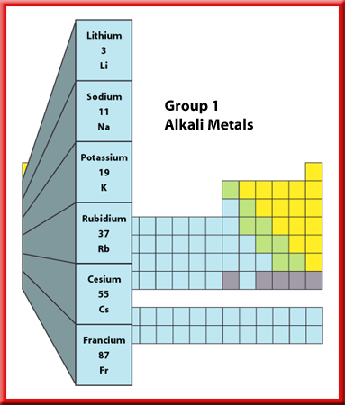
Representative Elements
Alkali Metals
The Group 1 elements have a specific family name—alkali metals.
All the alkali metals are silvery solids with
low densities and low melting points.
These elements increase in their reactivity, or tendency to combine with other substances, as you move from top to bottom.

Slide 5
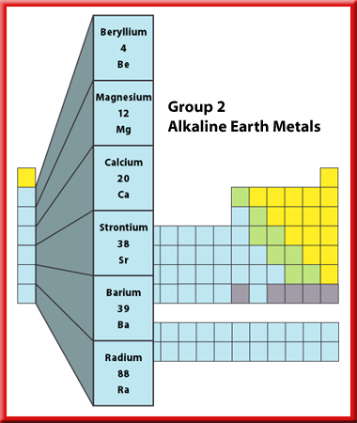
Representative Elements
Alkaline Earth Metals
Next to the alkali metals are the alkaline earth metals.
Each alkaline earth metal is denser and harder
and has a higher melting point than the alkali metal in the same period.
Alkaline earth metals are reactive, but not as reactive as the alkali metals.

Slide 6
Group 1 – The alkali metals
Some facts…
1) These metals all have ___ electron in their outer shell
2) Reactivity increases as you go _______ the group. This is because the electrons are further away from the _______ every time a _____ is added, so they are given up more easily.
3) They all react with water to form an alkali (hence their name) and __________, e.g:
Potassium + water potassium hydroxide + hydrogen
2K_{(s)} + 2H₂O_{(l)} 2KOH_{(aq)} + H_{2(g)}
Words – down, one, shell, hydrogen, nucleus

Slide 7
This powerpoint was kindly donated to www.worldofteaching.com
http://www.worldofteaching.com is home to over a thousand powerpoints submitted by teachers. This is a completely free site and requires no registration. Please visit and I hope it will help in your teaching.

